Slide 1
OPTIMIZING RESOURCE ALLOCATION FOR 5G NETWORKS USING ADVANCED MACHINE LEARNING TECHNIQUES
Team Members:
21i320 Karthik R
21i343 Prithiv Vijai U G
21i344 Pukalvanan L
21i366 Vinu V
Project Guide
Dr. Anitha Kumari K
Associate Professor
Department of Information Technology
PSG College of Technology
Coimbatore.

Slide 2
Agenda
Problem Statement
Objective
Scope of the project
Literature Survey
Proposed Methodology
Work done so far
Requirements
Timeline
References

Slide 3
Problem Statement
The increasing demand for high-quality and real-time applications in 5G networks necessitates efficient resource allocation mechanisms in Edge Computing.
The challenge lies in dynamically allocating resources such as bandwidth and signal strength to different applications with varying latency requirements.
Achieving realistic resource allocation efficiency by analyzing these parameters is crucial for understanding and optimizing the efficiency of each user, ultimately enhancing the overall performance.

Slide 4
Objective
Real-Time 5G Data: Acquire or create efficient real-time 5G user data, including signal strength, application type, latency, and bandwidth metrics to ensure accurate and relevant inputs for analysis.
Analyze Correlation Factors: Investigate how all the factors correlate with resource allocation to identify key influences on network performance.
Evaluate Predictive Models: Explore and assess various predictive models to determine their effectiveness in forecasting resource allocation based on the collected dataset.
Optimize Resource Allocation: Further develop a model-driven framework to enhance resource allocation strategies based on predicted efficiency.

Slide 5
Scope of the Project
Data Collection and Generation: Focus on gathering or generating comprehensive real-time 5G user data, including metrics on signal strength, application types, latency, and bandwidth usage, to provide a solid foundation for analysis.
Parameter Analysis: Examine how different parameters such application type , latency, signal strength , bandwidth impact resource allocation, with a goal to uncover patterns and correlations that influence performance.
Model Development and Testing: Implement and test a variety of predictive models to assess their ability to accurately forecast resource needs, ensuring that the models are suited to handle real-time data effectively (single objective).

Slide 6
Literature Survey
S.No | Title and Authors of the paper | Publication Year and Conference | Inferences | Drawbacks
1. | 5G Traffic Prediction Based on Deep Learning. Zihang Gao. | Computational and Intelligence Neuroscience. (2022) | This paper introduces an SLSTM model for predicting 5G network traffic, which adapts its complexity and stabilizes output sequences, showing significant improvements over traditional methods. | The proposed SLSTM model could benefit from incorporating a broader spectrum of factors influencing 5G traffic to further enhance its predictive accuracy and applicability in real-world settings.
2. | Deep Learning Models Applied to Prediction of 5G Technology Adoption. Ikhlas Fuad Zamzami | Applied Sciences. (2023) | This paper employs DR, LSTM, and CNN deep learning models to predict 5G adoption factors using channel metrics, context metrics, cell metrics, and throughput data. It underscores the effectiveness of the proposed DR and CNN models, despite issues with LSTM's data quality. | ,The paper acknowledges limitations in dataset representation and the proposed deep learning algorithm's contextual understanding, suggesting potential for improvement in future research.

Slide 7
Cont’d
3. | Research on throughput prediction of 5G network based on LSTM. L. Li and T. Ye | Intelligent and Converged Networks. June 2022 | This paper proposes an LSTM-based wireless network traffic prediction model, showing promising prediction accuracy and training speed through simulations with different 5G service scheduling algorithms. | Further optimizations are needed for parameter settings and operational efficiency to enhance future performance and algorithm design.
4. | A Gradient Boosted Decision Tree-Based Influencer Prediction in Social Network Analysis N. Subramani, S. V. Easwaramoorthy, P. Mohan, M. Subramanian, V. Sambath. | Big Data Cogn. Comput. 2023 | The study demonstrates that the combination of Gradient Boosted Decision Trees (GBDT) and Chaotic Gradient-Based Optimizer (CGBO) is effective in predicting social media influencers. This approach significantly improves the accuracy of identifying users who can influence future behaviors within social networks. | One limitation noted in the paper is the reliance on historical interaction data, which may not always accurately predict future trends or account for sudden changes in user behavior or emerging influencers.

Slide 8
Cont’d
5. | Histogram-Based Algorithm for Building Gradient Boosting Ensembles of Piecewise Linear Decision Trees. Aleksei Guryanov. | International Conference on Analysis of Images, Social Networks, and Texts (AIST) in 2019. | The proposed histogram-based algorithm for building gradient boosting ensembles of piecewise linear trees achieves better quality with reduced ensemble size and inference time compared to modern gradient boosting libraries. | The algorithm’s performance may be limited by its reliance on specific dataset characteristics, which might not generalize well across all types of data.
6. | Slime Mould Algorithm: A Comprehensive Survey of Its Variants and Applications. F. S. Gharehchopogh, A. Ucan, T. Ibrikci, B. Arasteh, G. Isik. | Archives of Computational Methods in Engineering, 2023. | The Slime Mould Algorithm (SMA) is highly effective in solving various optimization problems due to its unique mathematical model and adaptive weights, which simulate the biological wave behavior of slime molds. | The effectiveness of the SMA can be limited by its dependency on specific problem characteristics, which may not generalize well across all types of optimization problems.

Slide 9
Cont’d
7. | Hyperparameter Optimization for Machine Learning Models Based on Bayesian Optimization. Jia Wu, Xiu-Yun Chen , Hao Zhang, Li-Dong Xiong , Hang Lei , Si-Hao Deng | Journal of electronic science and technology, vol. 17, no. 1, march 2019 | The paper presents a Bayesian optimization algorithm using Gaussian processes for hyperparameter tuning, which improves accuracy and reduces runtime compared to brute-force methods. | The approach may demand significant computational resources and expertise for setup, and the choice of prior distributions can affect performance.
8. | Regression model-based short-term load forecasting for load dispatch center. Saikat gochhait, deepak k. Sharma. | Journal of Applied Engineering and Technological Science Vol 4(2) 2023 | The paper demonstrates that Bayesian optimization with Gaussian processes enhances accuracy and reduces runtime for hyperparameter tuning compared to brute-force methods. | The approach may require substantial computational resources for optimization, particularly with complex models and large datasets.

Slide 10
Drawbacks of existing system
Absence of Efficiency Metrics: Previous systems lacked metrics to gauge resource allocation efficiency, which hindered performance assessment and improvement.
Unclear Influence of Parameters: There was a limited understanding of how parameters like signal strength and latency affected resource allocation, which impeded accurate analysis and adjustment.
Limited Optimization Capabilities: Inadequate measurement tools previously prevented effective optimization, leading to inefficient resource use and diminished network performance.
Resulting Issues: Inefficient resource allocation resulted in increased latency, poor application performance, user dissatisfaction, and network congestion, leading to higher costs and reduced overall system efficiency.

Slide 11
Proposed methodology
Incorporated Machine Learning Models: Machine learning models were trained on the dataset to analyze the impact of features such as latency, signal strength, required bandwidth, and allocated bandwidth on resource allocation efficiency. A predictive formula for efficiency was developed based on these analyses.
Improved Efficiency Prediction: Various models, including regression-based, tree-based, and boosting-based approaches, were evaluated. Their performance was compared using relevant metrics, and the most suitable model was selected. Its parameters were optimized using various techniques to enhance the accuracy of resource allocation efficiency predictions.

Slide 12
Proposed methodology
Optimized Model Performance : used it to handle the missing formula for efficiency. Refined the chosen model's parameters using various optimization techniques to enhance the accuracy of predictions regarding resource allocation efficiency.
Model Comparison and Selection: Analyzed the performance of different models to select the one that best predicted efficiency. Utilized metrics to gauge their effectiveness and ensured the selected model provided the most reliable predictions.

Slide 13
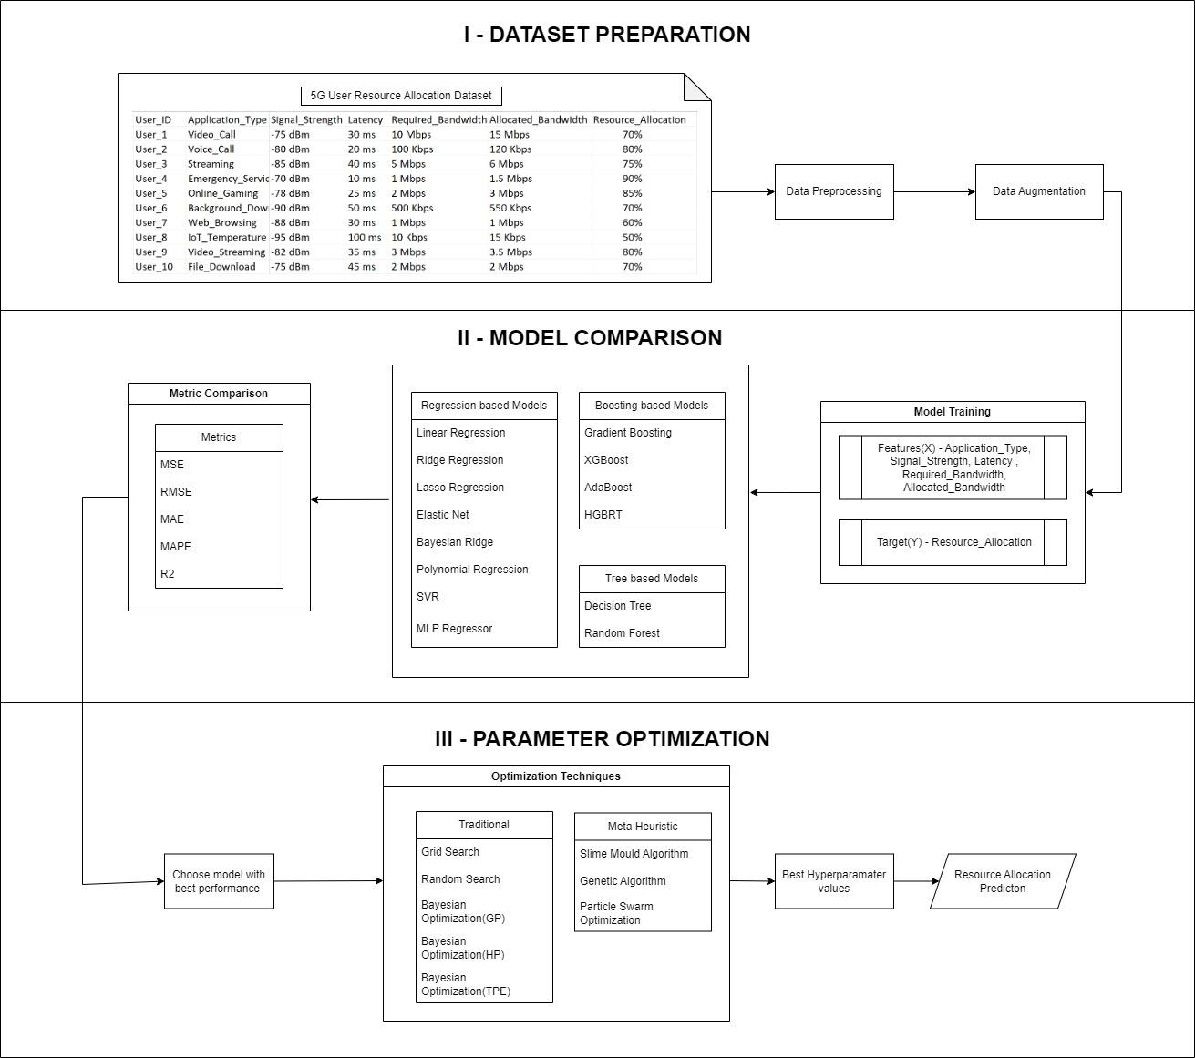
Proposed methodology – Block diagram

Slide 14
(I) Dataset preparation

Slide 15
Data Preprocessing
Removed Timestamp: Eliminated the Timestamp attribute.
Encoded Application Type: Applied numeric encoding to application_type.
Standardized Bandwidth: Unified units for Required_bandwidth and Allocated_bandwidth.
Stripped Symbols: Removed ‘%’, ‘dBm’, and ‘ms’ from attributes.
Refined User ID: Ensured User_Id contains only the ID
Original Dataset
Timestamp | User_ID | Application_Type | Signal_Strength | Latency | Required_Bandwidth | Allocated_Bandwidth | Resource_Allocation
09-03-2023 10:00 | User_1 | Video_Call | -75 dBm | 30 ms | 10 Mbps | 15 Mbps | 70%
09-03-2023 10:00 | User_2 | Voice_Call | -80 dBm | 20 ms | 100 Kbps | 120 Kbps | 80%
09-03-2023 10:00 | User_3 | Streaming | -85 dBm | 40 ms | 5 Mbps | 6 Mbps | 75%
09-03-2023 10:00 | User_4 | Emergency_Service | -70 dBm | 10 ms | 1 Mbps | 1.5 Mbps | 90%
09-03-2023 10:00 | User_5 | Online_Gaming | -78 dBm | 25 ms | 2 Mbps | 3 Mbps | 85%
09-03-2023 10:00 | User_6 | Background_Download | -90 dBm | 50 ms | 500 Kbps | 550 Kbps | 70%
09-03-2023 10:00 | User_7 | Web_Browsing | -88 dBm | 30 ms | 1 Mbps | 1 Mbps | 60%
09-03-2023 10:00 | User_8 | IoT_Temperature | -95 dBm | 100 ms | 10 Kbps | 15 Kbps | 50%
09-03-2023 10:00 | User_9 | Video_Streaming | -82 dBm | 35 ms | 3 Mbps | 3.5 Mbps | 80%
Preprocessed Dataset
User_ID | Application_Type | Signal_Strength | Latency | Required_Bandwidth | Allocated_Bandwidth | Resource_Allocation
1 | 6 | -75 | 30 | 10000 | 15000 | 70
2 | 9 | -80 | 20 | 100 | 120 | 80
3 | 5 | -85 | 40 | 5000 | 6000 | 75
4 | 1 | -70 | 10 | 1000 | 1500 | 90
5 | 4 | -78 | 25 | 2000 | 3000 | 85
6 | 0 | -90 | 50 | 500 | 550 | 70
7 | 10 | -88 | 30 | 1000 | 1000 | 60
8 | 3 | -95 | 100 | 10 | 15 | 50
9 | 7 | -82 | 35 | 3000 | 3500 | 80

Slide 16
Data Augmentation
Augmented Dataset: Expanded the dataset from 400 to 16,000 records.
Equal Distribution: Ensured balanced distribution across each application_type.
Comparison of Techniques: Evaluated correlation differences for various augmentation methods, including:
Random Over Sampling
Gaussian Noise Augmentation
GAN
MLP – ANN
SMOGN
Consistency of Features: Maintained consistent average values for each feature.
Correlation Results: Observed similar correlation outcomes across all augmentation methods and used the best method with higher correlation similarity.

Slide 17
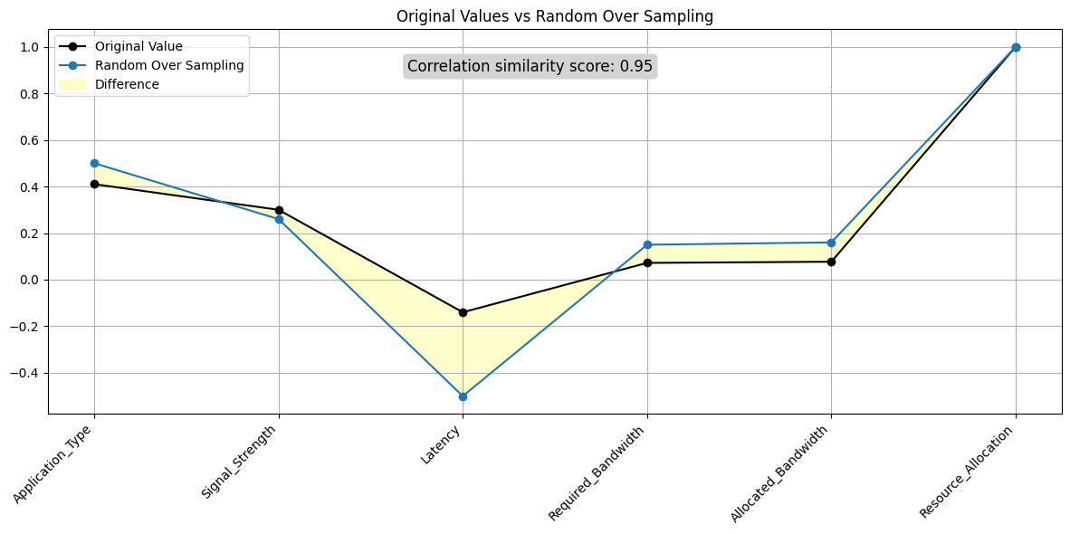
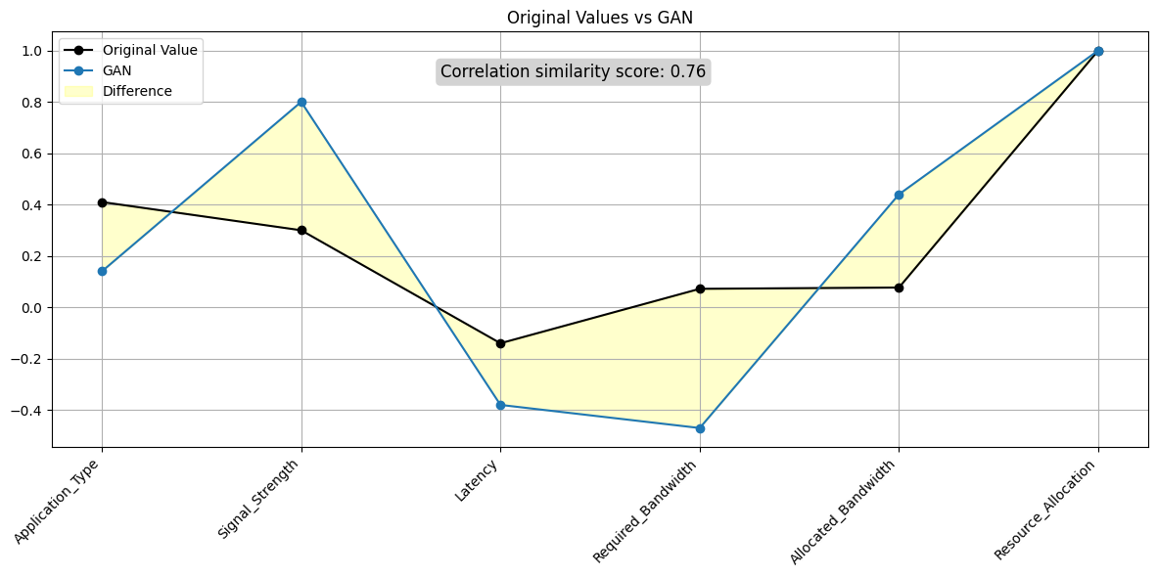
Correlation similarity with original dataset
Random Over Sampling
GAN
Random Over Sampling Correlation: 0.95
GAN Correlation: 0.76

Slide 18
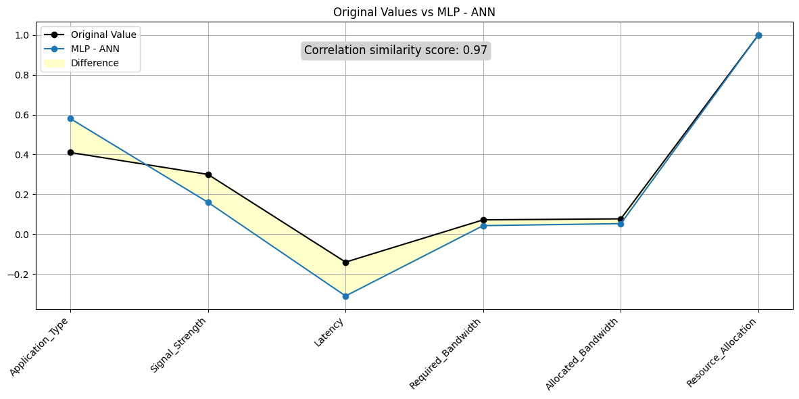
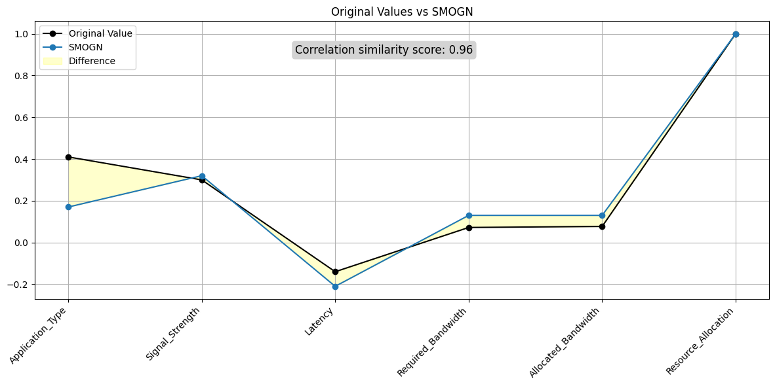
Correlation similarity with original dataset
MLP-ANN
SMOGN
MLP - ANN Correlation: 0.97
SMOGN Correlation: 0.96

Slide 19
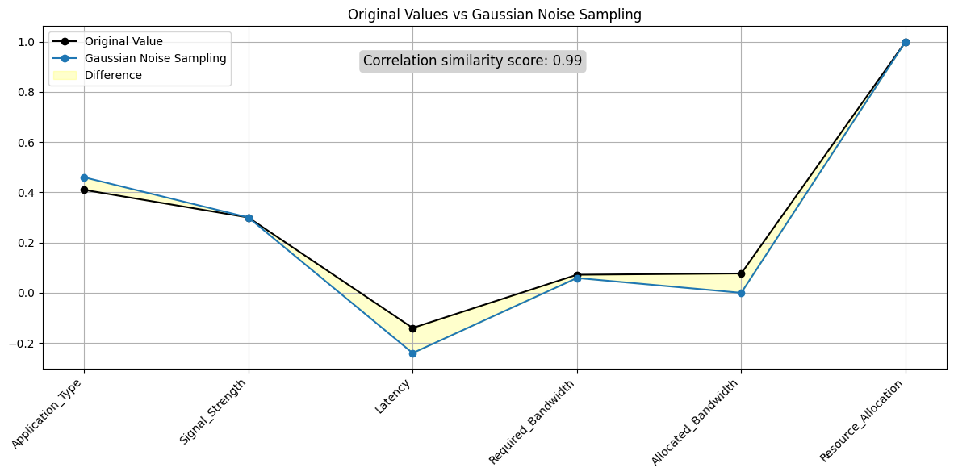
Correlation similarity with original dataset
Gaussian Noise Sampling
Augmented dataset with Gaussian Noise Sampling method gives the highest correlation similarity score – 0.99

Slide 20
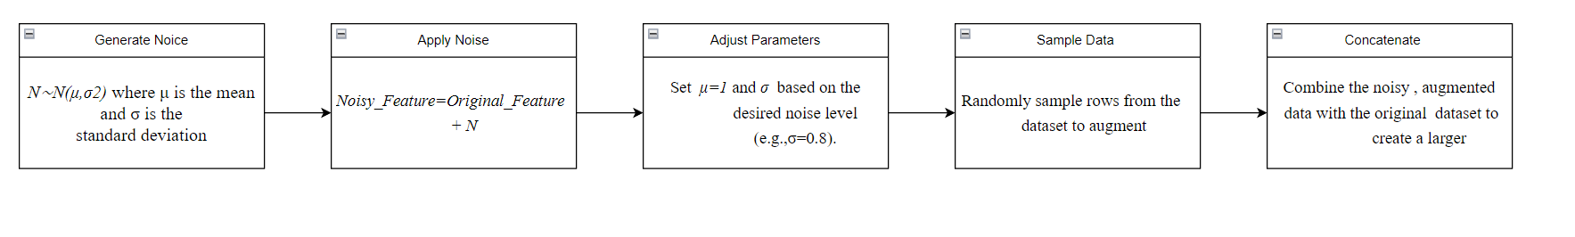
Data Augmentation – Gaussian Noise Sampling Flow Chart

Slide 21
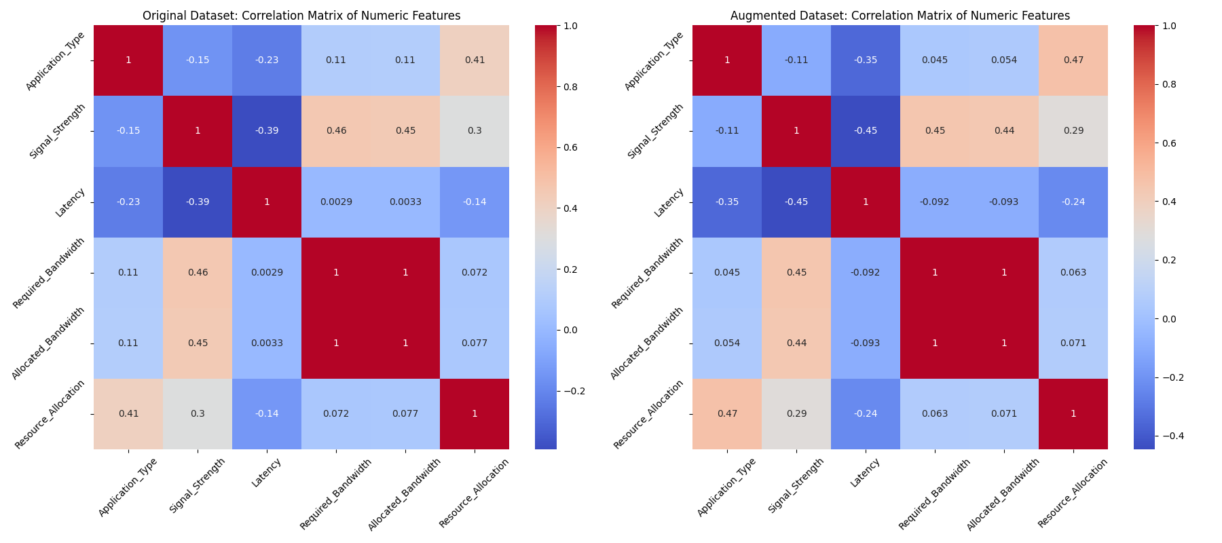
Data Augmentation - Correlation similarity with original dataset
Correlation Matrix of Original dataset vs Augmented dataset (Gaussian Noise Sampling)

Slide 22
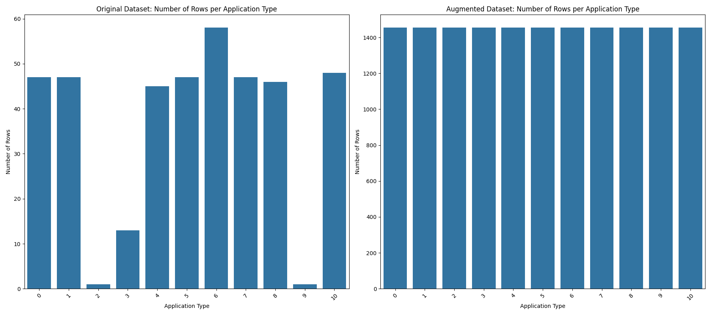
Data Augmentation – Comparitive Analysis
Number of data in Original dataset vs Augmented dataset (Gaussian Noise Sampling)
for Each Application Type

Slide 23
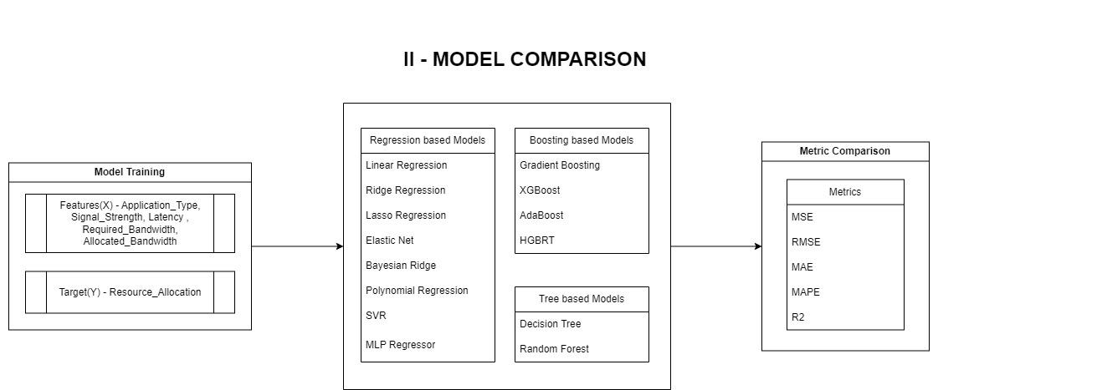
(II) Model Comparison

Slide 24
Regression Based Models
Linear Regression: Linear Regression is a fundamental regression technique where the model predicts a continuous target variable based on a linear relationship with one or more features.
Parameters: None
Ridge Regression: Adds regularization to Linear Regression to prevent overfitting by penalizing large coefficients.
Parameters: alpha: 0.5 controls the strength of the regularization.
Lasso Regression: Similar to Ridge, but with L1 regularization, which can set some coefficients to zero, effectively selecting features.
Parameters: alpha: 0.5

Slide 25
Regression Based Models
Elastic Net: Combines L1 and L2 regularization from Lasso and Ridge, balancing their benefits.
Parameters: alpha: 0.5
l1_ratio: 0.7 it determines the mix of L1 and L2 regularization. A value of 0.7 means that L1 regularization (Lasso) is more influential, leading to more feature selection.
Bayesian Ridge: A probabilistic model that incorporates prior distributions into the regression analysis.
Parameters : alpha_1: 1e-6 ,alpha_2: 1e-6, lambda_1: 1e-6 , lambda_2: 1e-6 . These parameters control the prior distributions of the coefficients and their variances. Lower values (e.g., 1e-6) make the prior distributions weaker, allowing for greater flexibility in fitting the model.

Slide 26
Regression Based Models
Polynomial Regression: Extends Linear Regression by fitting a polynomial equation, capturing non-linear relationships.
Parameter : degree: 3 - specifies the degree of the polynomial features. A higher degree can capture more complex relationships but risks overfitting.
SVR (Support Vector Regression): Uses support vector machines to perform regression, focusing on the margins of the best fit line.
Parameters : C: 10 it controls the trade-off between smoothness and accuracy.
epsilon: 0.1 defines the margin within which errors are tolerated.
kernel: 'rbf’ defines the function used to map the data into a higher-dimensional space..

Slide 27
Regression Based Models
MLP Regressor: A neural network-based regressor that can capture complex, non-linear relationships
Parameters: hidden_layer_sizes: (100,) defines the number and size of hidden layers in the neural network. More layers or neurons can capture more complex patterns but increase the risk of overfitting.
activation: 'relu' specifies the activation function used in the neurons.
solver: ‘adam’ determines the optimization algorithm used for training the network.

Slide 28
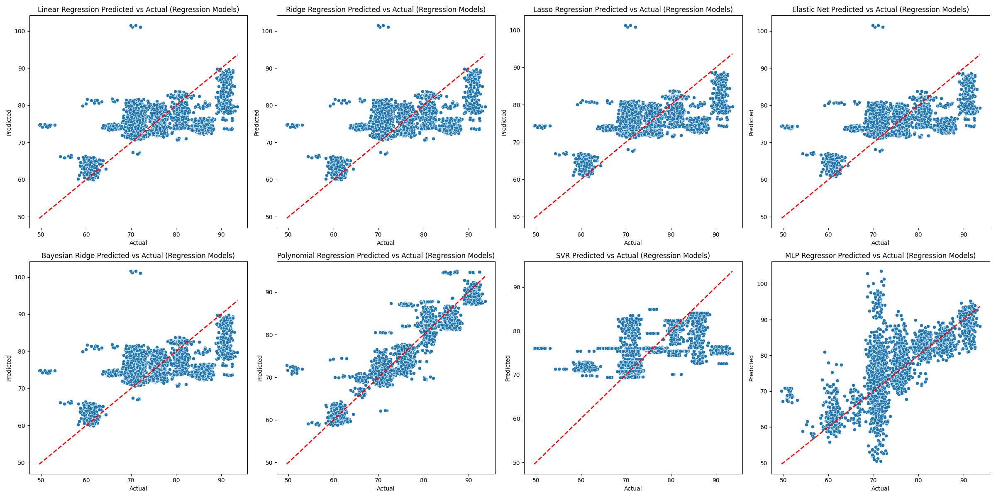
Regression models - Actual vs Predicted
Scatter plot graph of Regression Models

Slide 29
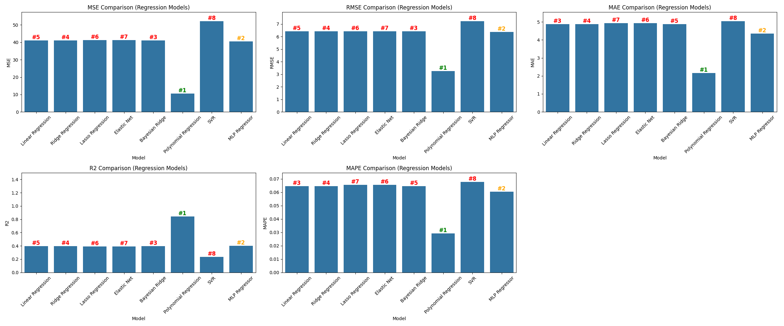
Regression models – Metric comparison
Metric Comparison of Regression Models (Best – Polynomial regression)

Slide 30
Tree Based Models
Decision Tree Regressor: Splits the data into subsets based on the feature that results in the most homogenous subsets.
Parameters : max_depth: 10 limits the maximum depth of the tree. Deeper trees can capture more complex relationships but may overfit. Shallow trees generalize better but may miss nuances.
min_samples_split: 5 specifies the minimum number of samples required to split an internal node. Higher values prevent the tree from growing too deep and reduce overfitting.
min_samples_leaf: 2 defines the minimum number of samples required to be at a leaf node. It ensures that leaf nodes have enough samples to make reliable predictions.

Slide 31
Tree Based Models
Random Forest Regressor: An ensemble method that uses multiple decision trees to improve predictive accuracy and control overfitting.
Parameters: n_estimators: 200 defines the number of trees in the forest. More trees generally improve performance and robustness but increase computation time.
max_depth: 20 limits the depth of individual trees in the forest. A higher depth allows each tree to capture more detail, while a lower depth helps prevent overfitting.
min_samples_split: 10 controls the minimum number of samples required to split an internal node. Higher values reduce overfitting by limiting tree complexity.

Slide 32
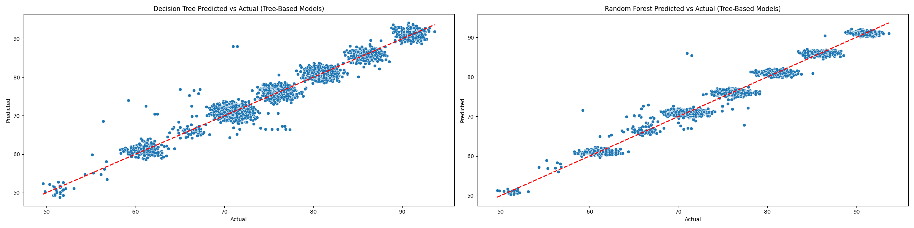
Tree based models – Actual vs Predicted
Scatter Plot Graph of Tree Based Models

Slide 33
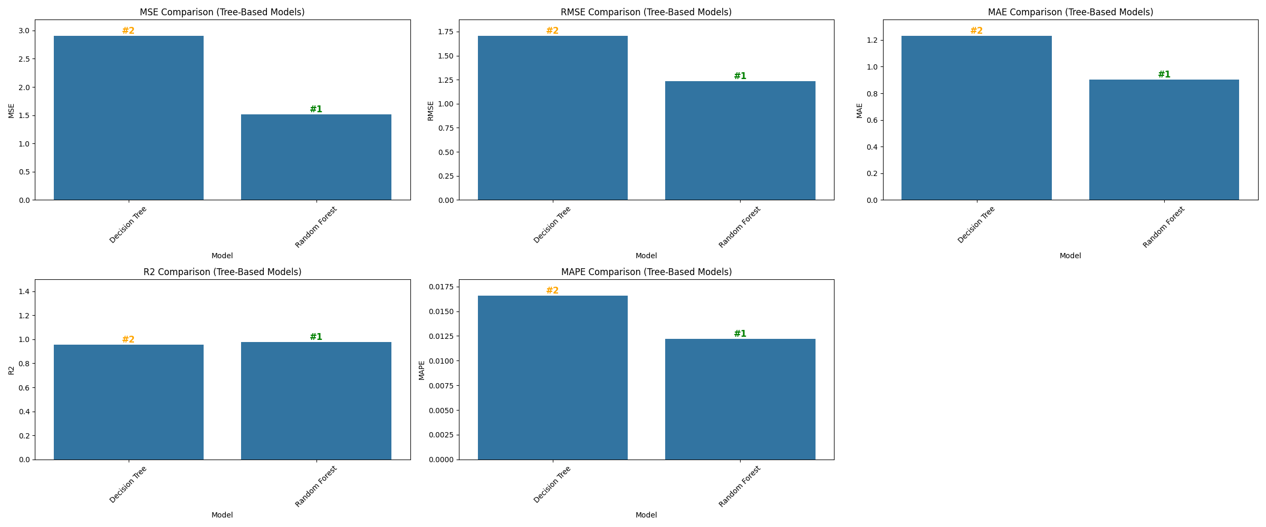
Tree based models – Metrics Comparison
Metric Comparison of Tree Based Model (Best – Random forest)

Slide 34
Boosting based Models
Gradient Boosting Regressor: Sequentially builds models by focusing on the errors of the previous ones, enhancing performance.
Parameters : n_estimators: 150 defines the number of boosting stages. More stages can improve model performance but increase training time.
learning_rate: 0.1 controls the contribution of each boosting stage. A lower rate requires more stages to achieve the same performance but can lead to better results.
max_depth: 5 limits the depth of each individual tree. It controls the complexity of each tree and helps prevent overfitting.

Slide 35
Boosting based Models
AdaBoost Regressor: Adjusts the weights of incorrectly predicted instances to improve model accuracy.
Parameters : n_estimators: 100 defines the number of boosting stages. More stages generally improve performance but require more training time.
learning_rate: 0.1 controls the contribution of each boosting stage. A lower rate increases the number of stages needed but can lead to better model performance.

Slide 36
Boosting based Models
XGBoost: An optimized version of Gradient Boosting that is efficient and widely used in competitive machine learning.
Parameters : n_estimators: 100 defines the number of boosting stages. More stages can improve performance but increase training time.
learning_rate: 0.1 controls the contribution of each boosting stage. Lower values improve performance but may require more stages.
max_depth: 6 limits the depth of individual trees. It helps control overfitting by limiting the complexity of each tree.

Slide 37
Boosting based Models
HGBRT: Histogram Gradient Boosting (HGB) is an optimized version of Gradient Boosting that enhances speed and efficiency
Parameters : n_estimators: 100 defines the number of boosting stages. More stages generally improve model performance but increase training time.
learning_rate: 0.1 controls the contribution of each boosting stage. Lower values can lead to better performance but require more stages.
max_depth: none limits the depth of trees, controlling model complexity and overfitting.
num_leaves: 31 controls the complexity of each tree. More leaves allow the model to capture more details but can lead to overfitting.

Slide 38
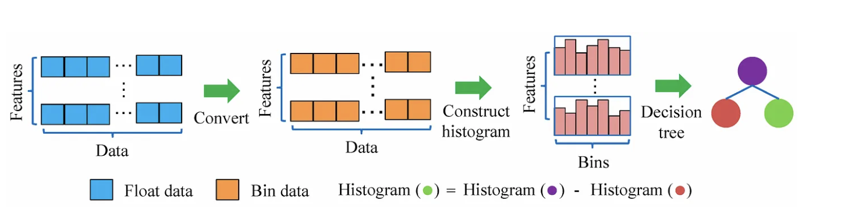
Model Selection - HGBRT

Slide 39
Histogram based Gradient Boosting Regressor (HGBRT)
1. Input Data : Load features XXX and target yyy.
2. Initialization : Set initial prediction F0(x)F_0(x)F0​(x), usually the mean of yyy.
3. Boosting Iterations (m = 1 to M)
a. Calculate Residuals : Compute the difference between the actual values and the current predictions (i.e., the error or residuals).
b. Construct Histograms : Divide feature values into bins to make the next steps faster.
c. Fit Decision Tree : Train a decision tree that predicts the residuals (errors) from the previous model.
d. Optimize Leaf Values : Find the best output values for the leaves (tree predictions) to reduce the prediction error.

Slide 40
Histogram based Gradient Boosting Regressor (HGBRT)
e. Update Model : Update the current model by adding the predictions from the new decision tree, scaled by a learning rate(η) to control the step size(Fm​(x)=Fm−1​(x)+η⋅Treem​(x)).
4. Final Model : Combine all the trees to form the final model(FM​(x)=F0​(x)+∑^{M}_{m=1​} η⋅Treem​(x)).
5. Prediction : Use the final modell to make predictions for new input data.

Slide 41
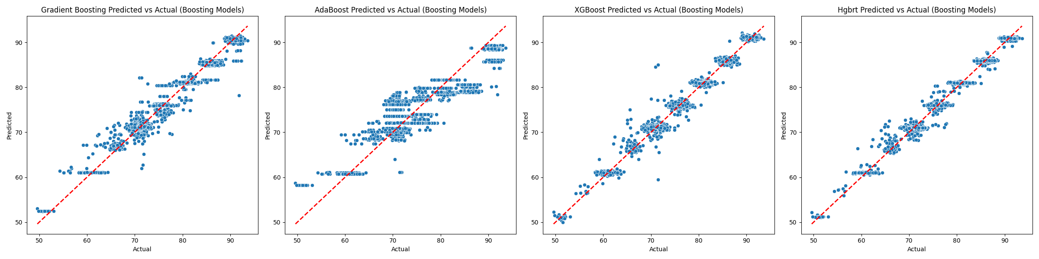
Boosting models– Actual vs Predicted
Scatter Plot Graph of Boosting Model.

Slide 42
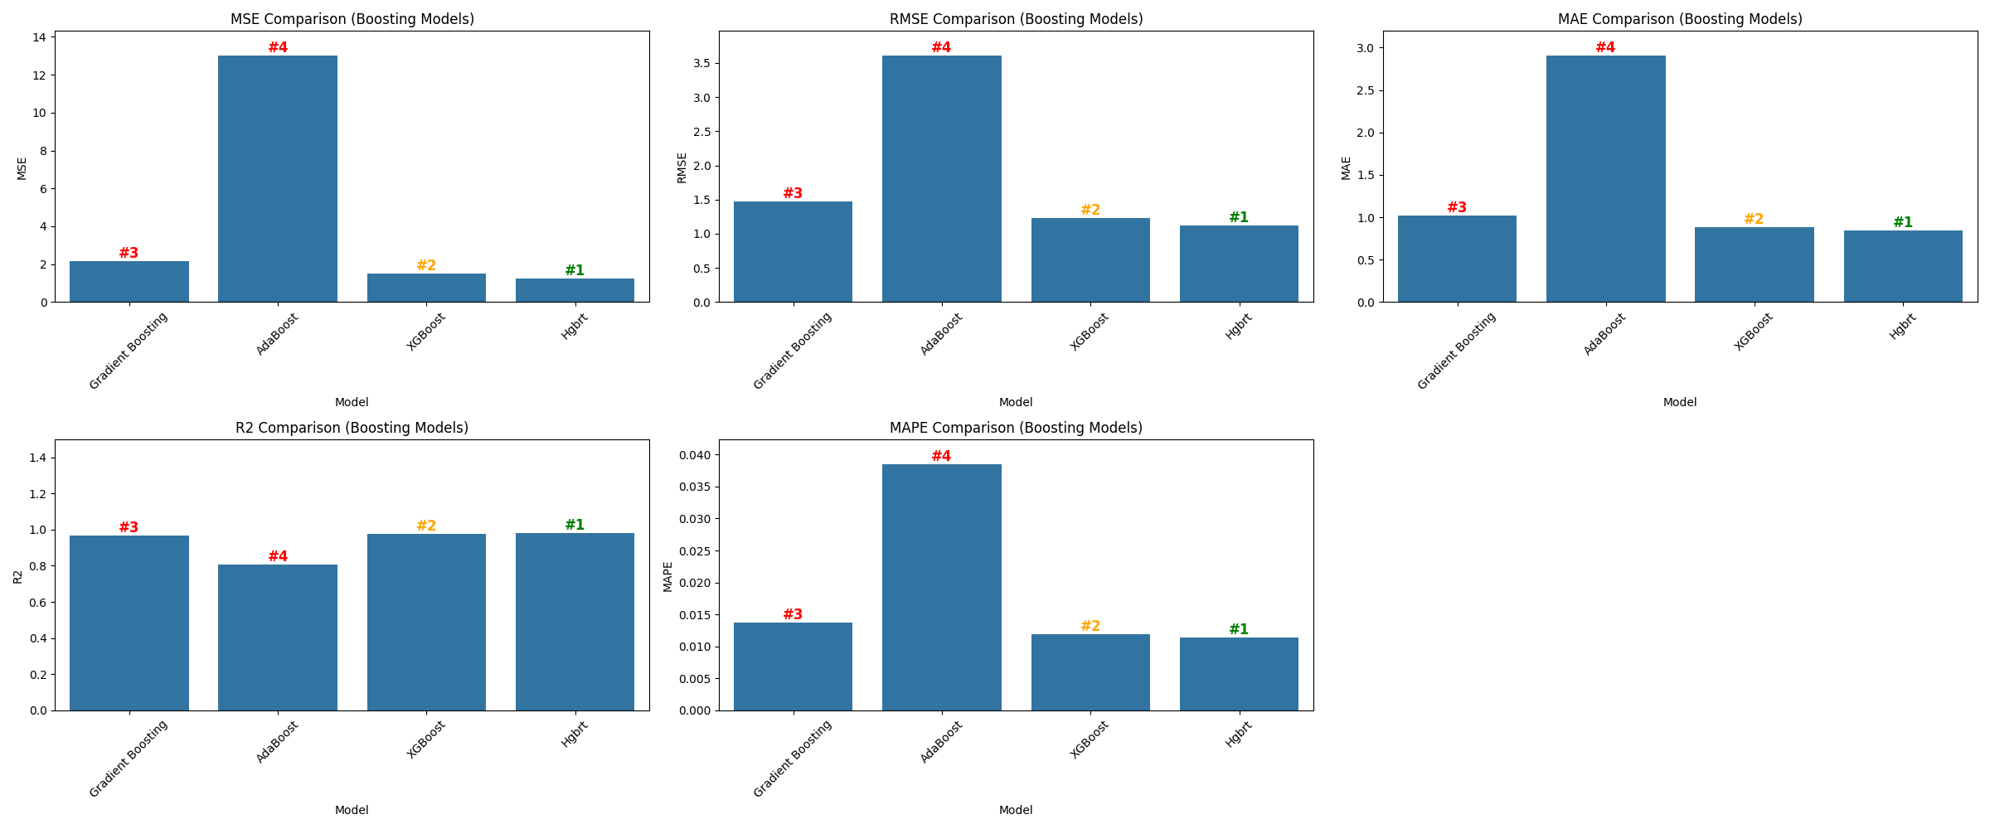
Boosting models – Metrics Comparison
Metric comparison of Boosting based Models(Best – HGBRT)

Slide 43
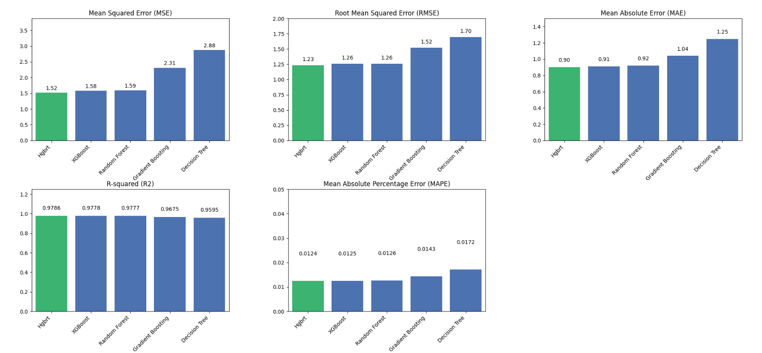
Consolidated Model Comparison
Top 5 performing models

Slide 44
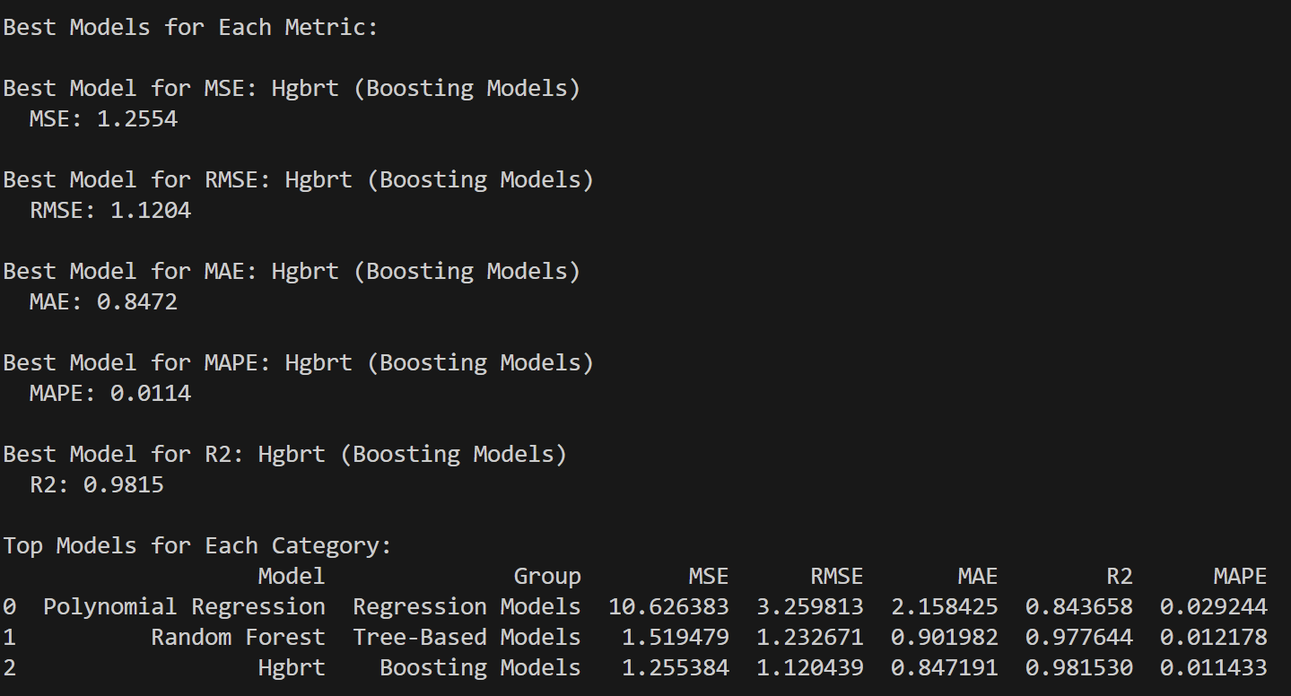
Consolidated model comparison
Overall best metrics

Slide 45
Histogram based Gradient Boosting Regressor (HGBRT)
Why Use Histogram Gradient Boosting?
Speed: Binning features reduces the computational burden, speeding up training times. Also optimal for further parameter tuning.
Efficiency: Uses less memory, making it suitable for large datasets.
Performance: Despite being faster, HGB often performs as well as or better than traditional Gradient Boosting models .

Slide 46
(II) Paramater Optimization

Slide 47
HGBRT - Parameters
learning_rate: Controls how much each tree contributes to the overall model.
Larger values speed up training but risk overfitting, while smaller values improve accuracy with more iterations.
max_iter: The maximum number of boosting iterations (or trees).
Larger values allow the model to learn more but increase computation time, while smaller values result in faster training at the cost of reduced learning.
max_leaf_nodes: Limits the number of leaves per tree, which can help control the model’s complexity.
Larger values make trees more flexible but can lead to overfitting, while smaller values produce simpler models that may underfit.

Slide 48
HGBRT - Parameters
max_depth: Sets the maximum depth of each tree.
Larger values allow for more complex trees, which may overfit, while smaller values limit complexity and help prevent overfitting but may underfit.
min_samples_leaf: The minimum number of samples required in a leaf.
Larger values make the model more generalized by requiring more data in each leaf, while smaller values allow for finer splits but may lead to overfitting.
l2_regularization :Adds a penalty for large coefficients, which helps prevent overfitting.
Larger values reduce overfitting but might underfit, while smaller values allow for more complex models but increase the risk of overfitting.

Slide 49
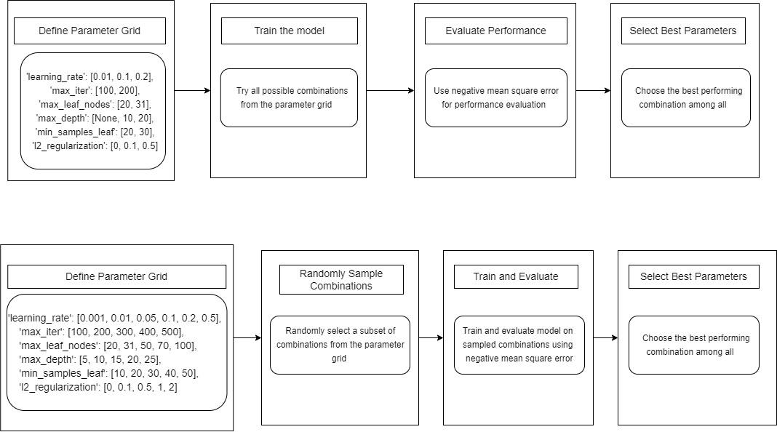
Grid search

Slide 50
Random search

Slide 51
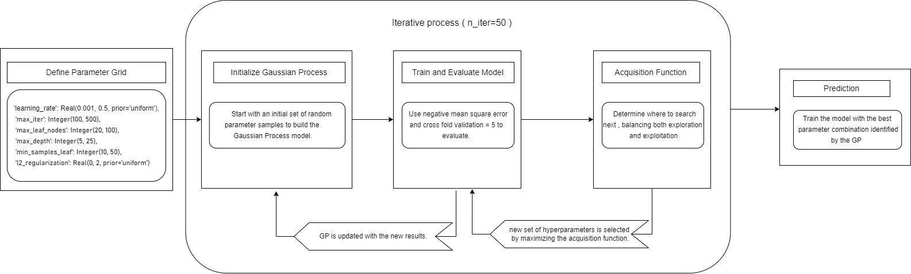
Bayesian Optimization (GP)

Slide 52
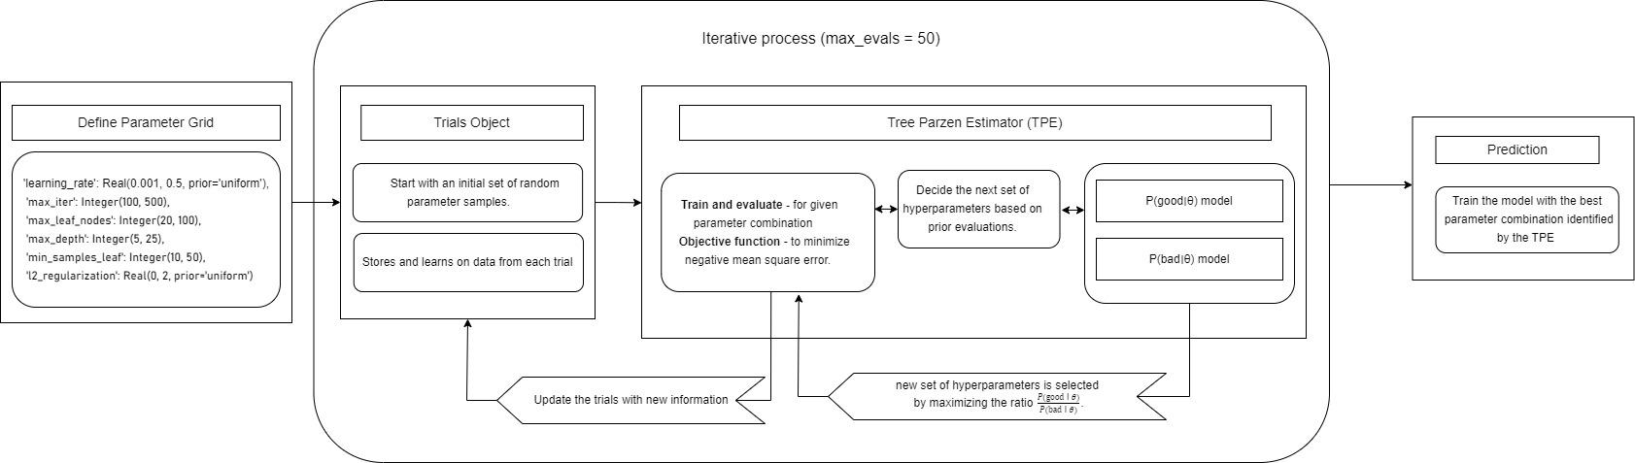
Bayesian Optimization (TPE)

Slide 53
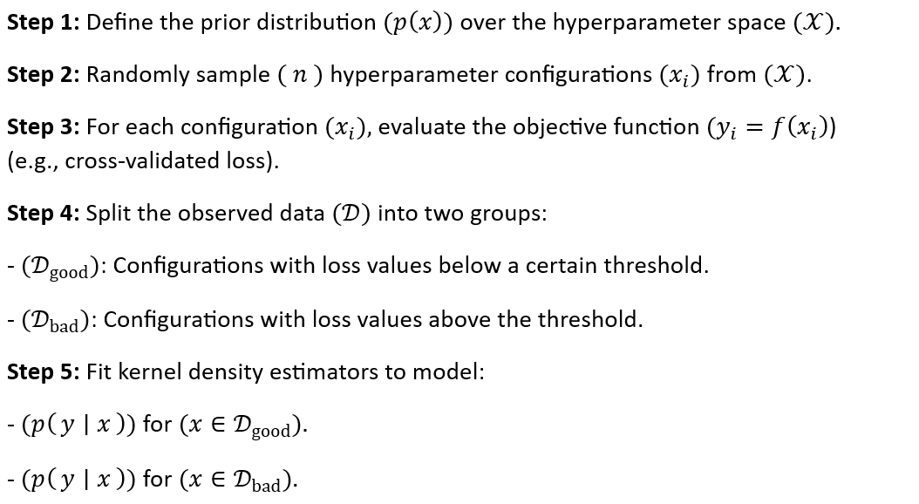
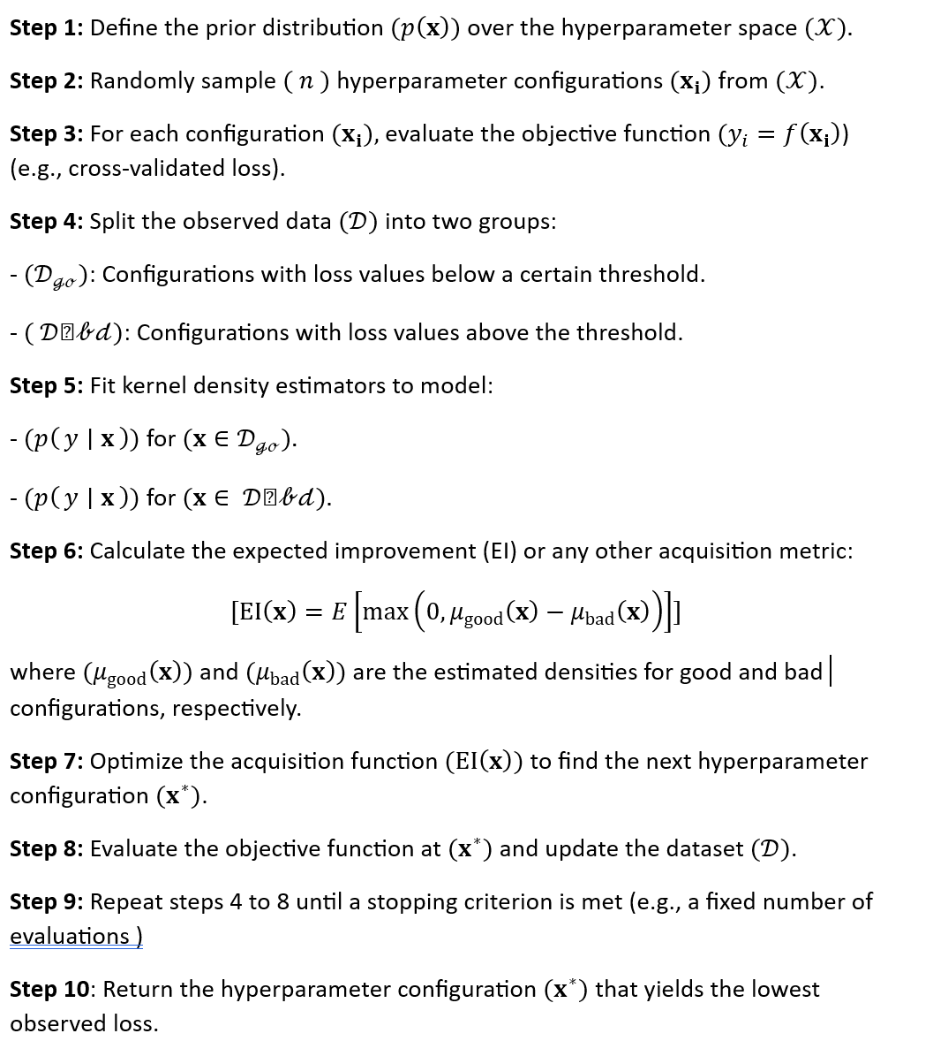
Bayesian Optimization (TPE) - Algorithm

Slide 54
Bayesian Optimization (TPE) - Algorithm

Slide 55
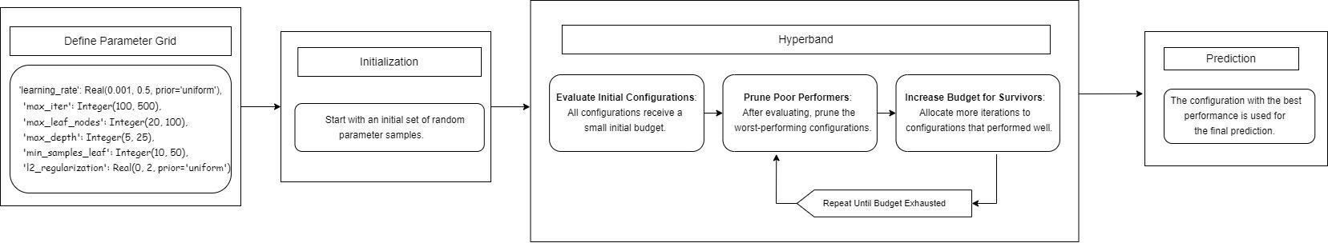
Bayesian Optimization (Hyperband)

Slide 56
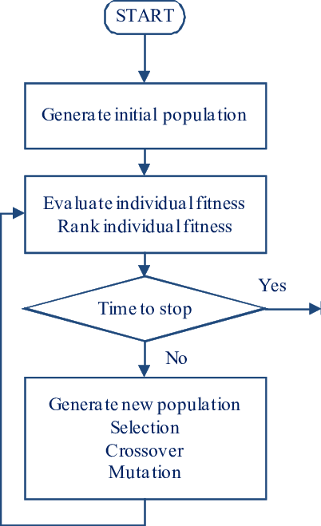
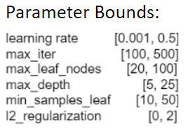
Genetic Algorithm

Slide 57
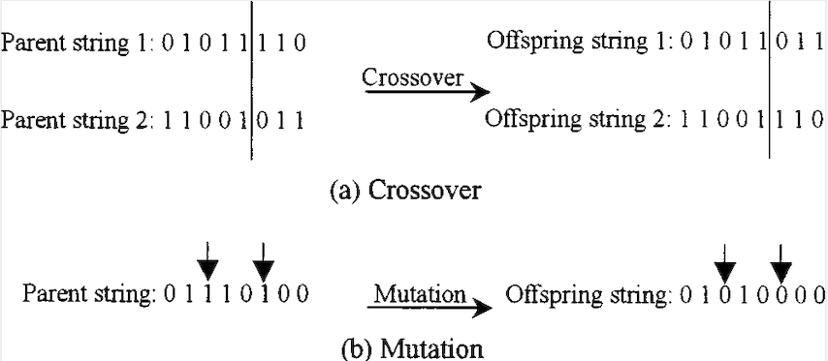
Genetic Algorithm

Slide 58
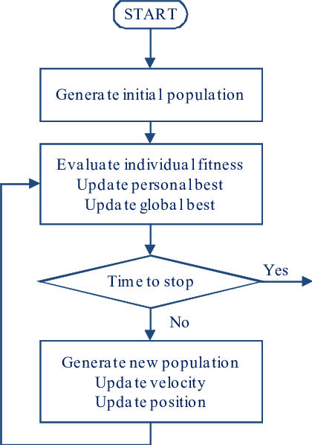
Particle Swarm Optimization

Slide 59
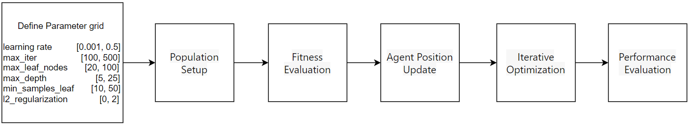
Slime Mould Algorithm

Slide 60
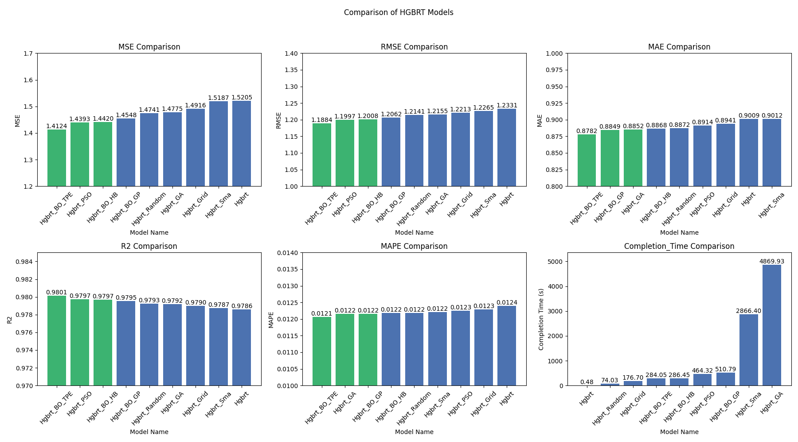
Optimization Techniques Comparison

Slide 61
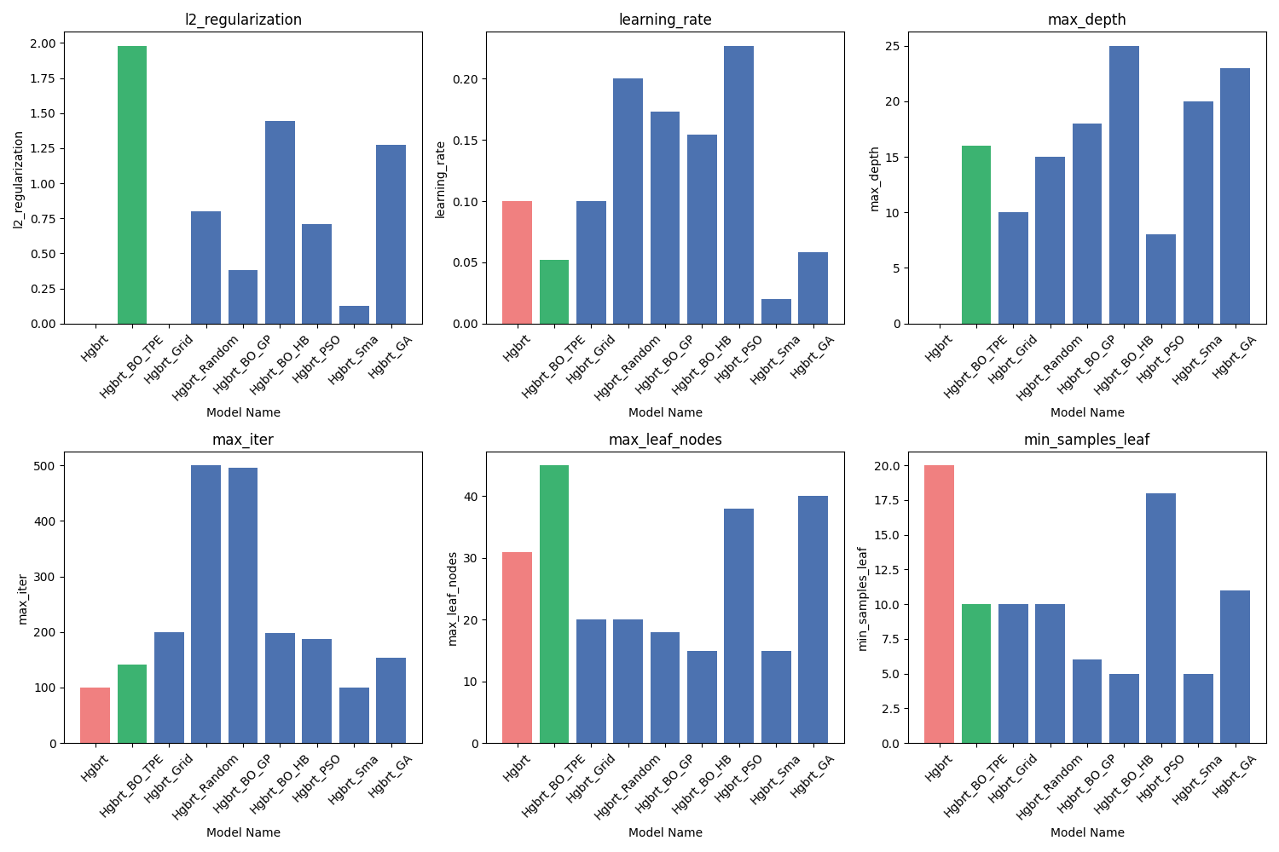


Best Hyper-parameters
best performing model
default hyperparameter

Slide 62
Conclusion
Out of all the Machine Learning algorithms, HGBRT was the best.
And out of all the hyperparameter tuning algorithms, Bayesian Optimization - TPE performed the best with R2 value as 0.9801
The optimal values for the HGBRT parameters are, l2_regularization - 1.9804935266969126
learning_rate - 0.052186054713003985
max_depth - 16
max_iter - 141
max_leaf_nodes - 45
min_samples_leaf - 10

Slide 63
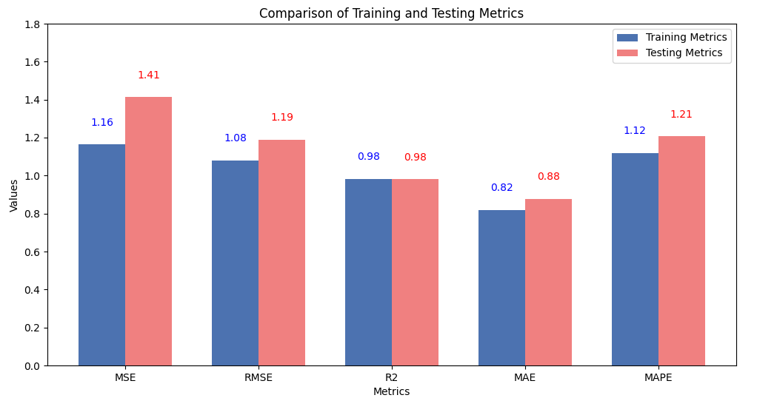
Conclusion
No Significant Overfitting or Underfitting: Given that both the training and testing metrics are close and the R² values are high, it suggests that the model is neither overfitting nor underfitting. It appears to be fitting the data well.

Slide 64
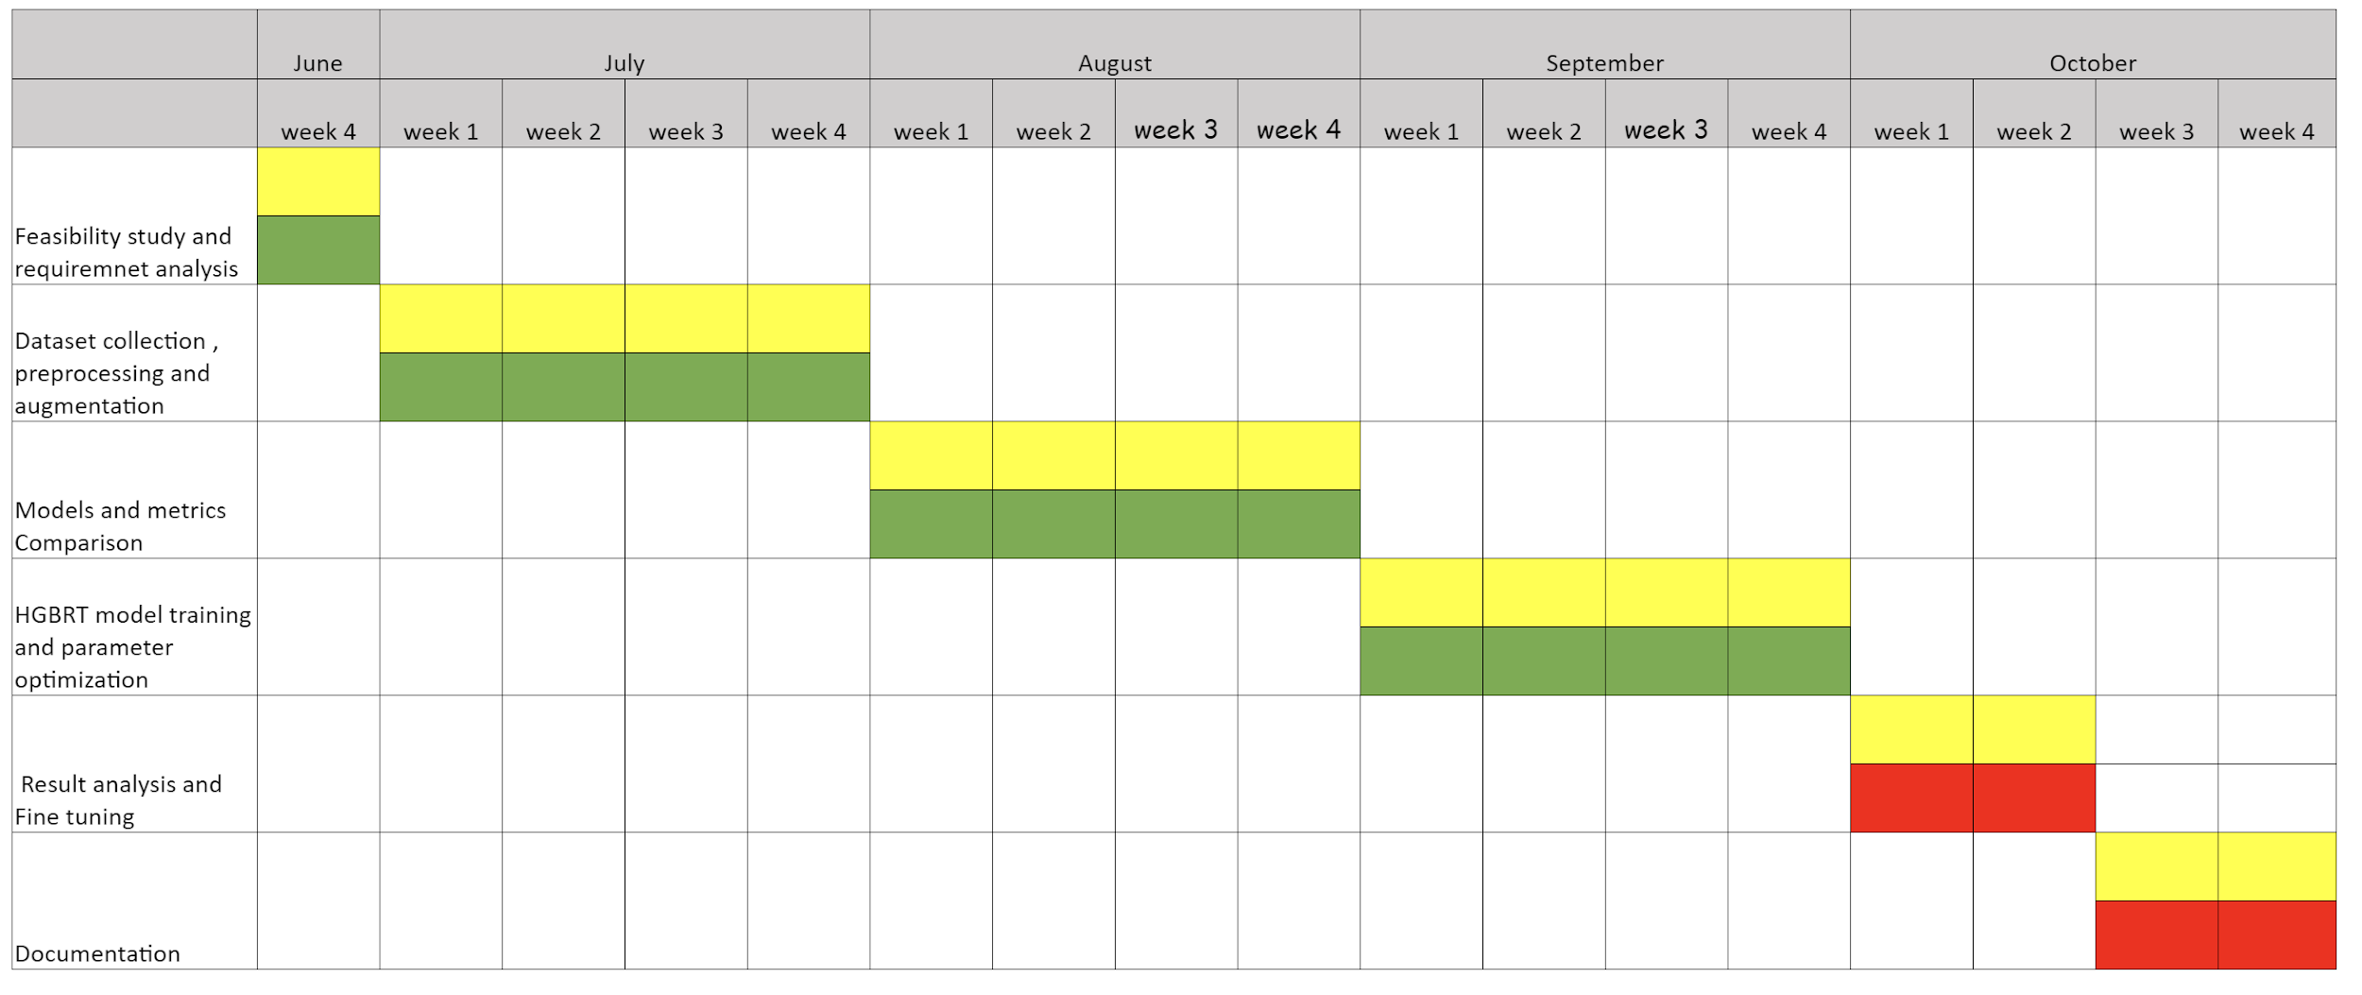
Timeline chart
Work done
Works Assigned
Works to be done

Slide 65
References
Gao Z. 5G Traffic Prediction Based on Deep Learning. Comput Intell Neurosci. 2022 Jun 24;2022:3174530. doi: 10.1155/2022/3174530. PMID: 35785055; PMCID: PMC9249458.
Zamzami, Ikhlas. (2022). Deep Learning Models Applied to Prediction of 5G Technology Adoption. Applied Sciences. 13. 119. 10.3390/app13010119.
L. Li and T. Ye, "Research on throughput prediction of 5G network based on LSTM," in Intelligent and Converged Networks, vol. 3, no. 2, pp. 217-227, June 2022, doi: 10.23919/ICN.2022.0006Qin, Z., Weng, J., Cui, Y., & Ren, K. Privacy-preserving image processing in the cloud. IEEE Cloud Computing (2018).
Subramani, N.; Veerappampalayam Easwaramoorthy, S.; Mohan, P.; Subramanian, M.; Sambath, V. A Gradient Boosted Decision Tree-Based Influencer Prediction in Social Network Analysis. Big Data Cogn. Comput. 2023, 7, 6.
Guryanov, A. (2019). Histogram-Based Algorithm for Building Gradient Boosting Ensembles of Piecewise Linear Decision Trees. In: van der Aalst, W., et al. Analysis of Images, Social Networks and Texts. AIST 2019. Lecture Notes in Computer Science(), vol 11832. Springer, Cham.

Slide 66
References
Gharehchopogh, F.S., Ucan, A., Ibrikci, T. et al. Slime Mould Algorithm: A Comprehensive Survey of Its Variants and Applications. Arch Computat Methods Eng 30, 2683–2723 (2023).
Jia Wu, Xiu-Yun Chen, Hao Zhang, Li-Dong Xiong, Hang Lei, Si-Hao Deng, Hyperparameter Optimization for Machine Learning Models Based on Bayesian Optimization, Journal of Electronic Science and Technology, Volume 17, Issue 1, 2019, Pages 26-40, ISSN 1674-862X.
Gochhait, S., & Sharma, D. . (2023). Regression Model-Based Short-Term Load Forecasting for Load Despatch Centre. Journal of Applied Engineering and Technological Science (JAETS), 4(2), 693–710.
Project Git-Hub link - https://github.com/Prithiv-vijai/5g_MEC

Slide 67
THANK YOU!

